Slide 1


Vrije Universiteit Amsterdam | 2025
Master Thesis Presentation
VISION-GUIDED ROBOTIC SYSTEM FOR BASIL HARVESTING
aka BasilBot
Presented by Marin Marian
University supervisor : Kevin S. Luck
Daily supervisor at Olivabot: Tony Currà
Notes:
Hello, everyone. My name is Marin, and today I’ll be presenting my Master’s thesis. This work was carried out in collaboration with Olivabot, an agricultural robotics startup. During my internship at Olivabot I have explored low-cost automation in agriculture using computer vision and robotics. More specifically, I have been working on a Vision-Guided Robotic System for Basil Harvesting or simply BasilBot.

Slide 2
Introduction
Background
Agriculture workforce is shrinking -2.5 mil. workers in EU
Manual basil harvesting is time-consuming and requires precision
Motivation
Need for low-cost, automated harvesting
Avoiding reliance on expensive sensors like depth cameras
Notes:
I will start with a short introduction.
First, agricultural labor shortages are becoming a major concern in the EU and also other parts of the world. Around 2.5 mil. workers have left the agricultural sector over the last decade in the EU.
Second, precision tasks like basil harvesting are still mostly done manually, due to the delicacy involved in cutting the correct leaf without damaging nearby parts. Also, existing commercial agricultural systems often rely on expensive hardware.
This project aims to automate basil harvesting using an affordable robotic arm guided by a vision-based system that can detect and cut basil leaves with precision, without relying on any expensive sensors like depth cameras.

Slide 3
Problem
Can a low-cost robotic system detect, approach and cut basil leaves with precision using only vision input from an RGB camera?
Notes:
The core problem is: (how) can I design a low-cost robotic system that can detect, localize, approach and cut basil leaves with precision using only vision-based input from an RGB camera?
This requires solving multiple challenges — including segmentation, decision-making, and precise robotic control — all under hardware constraints.

Slide 4
Objective
Petiole segmentation using a fine-tuned SAM model (LoRA-SAM)
Real-time image-based visual servoing
Precise cutting using a 3d-printed robotic arm
Notes:
The three key objectives of this thesis are:
- Training and deploying a segmentation model that can accurately detect a clear cutting area.
- Implementing real-time ib visual servoing to guide the robot
- and finally building a robotic arm that can execute reliable and precise cutting actions.

Slide 5
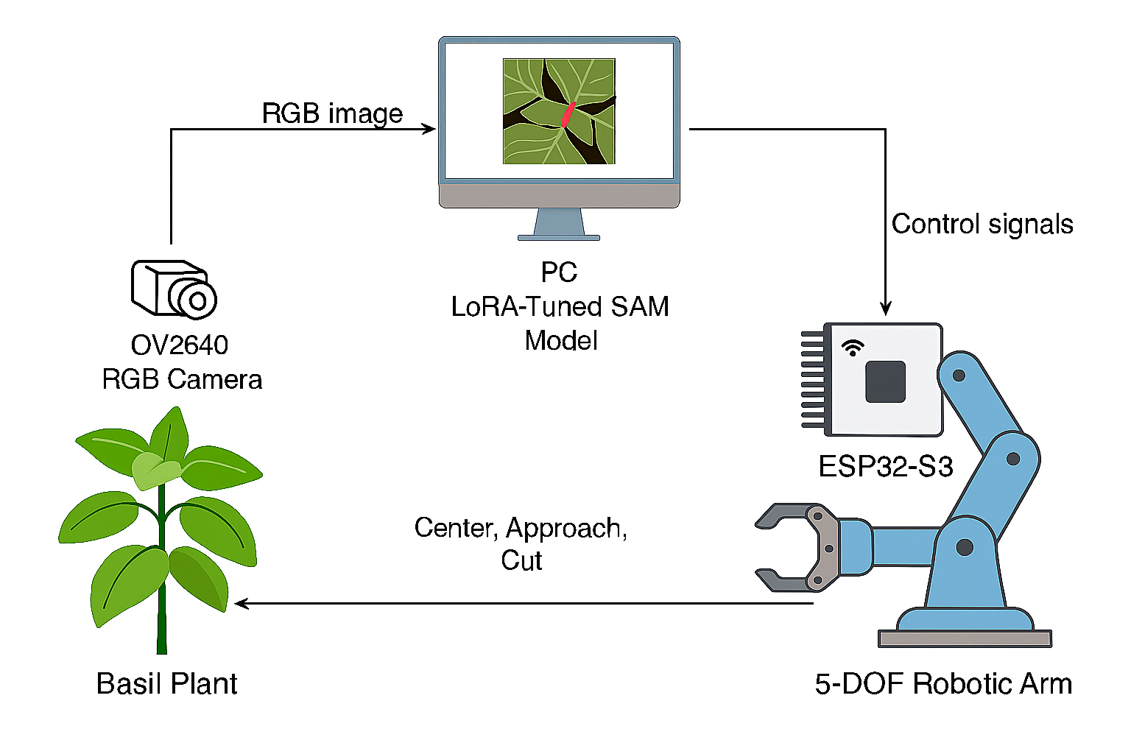
System Overview Diagram
Notes:
Here is the general full system architecture. We have low-resolution RGB camera that is actually mounted on the robotic arm, on the top of the end-effector. This camera sends a live video stream to the PC, where it runs a segmentation pipeline which is crucial to identifying the cutting point. Once determining our target, our cut point it sends action commands to a microcontroller which adjusts the servo motors of the robot accordingly to perform the actual movement and cutting.

Slide 6
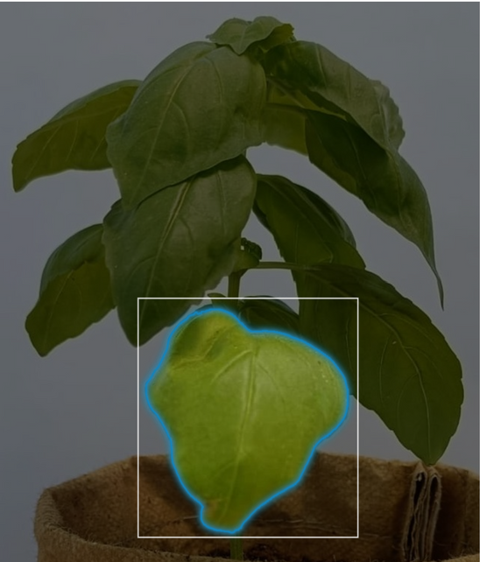
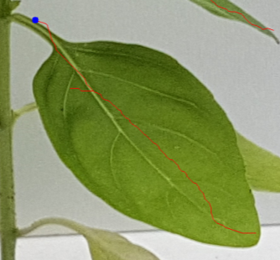
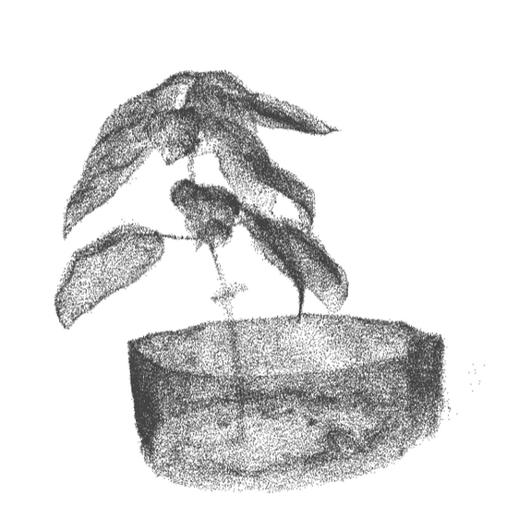
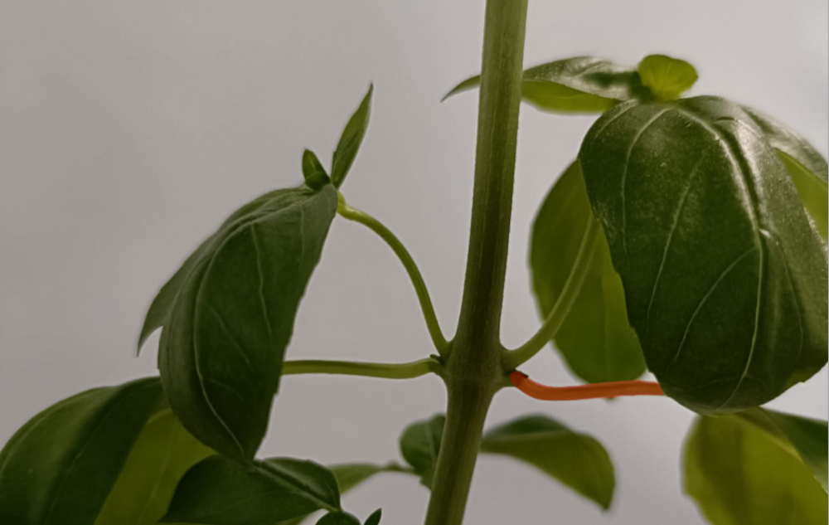
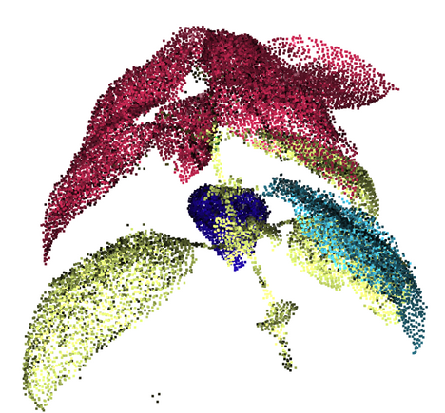
Earlier Approaches
Leaf detection
Leaf skeletonization
Vein tracking
3D reconstruction
PCA
Notes:
Before I explain more in depth my methodology, I would like you to understand how I arrived at my final approach. I will not go through all my earlier approaches but the main thing is that in the beginning, I tried detecting and segmenting entire leaves, specifically the largest leaf on the plant however, it quickly became clear that determining an appropriate cutting point was difficult because sometimes it was hidden behind overlapping leaves.
To address this, I explored different image
processing techniques to try and estimate where that point could be even if its not seen in the camera frame.
However, this proved unreliable in practice due to a lot of occlusions and ambiguity in the plant structure.
As a result, I shifted my focus to a more targeted approach:
petiole segmentation (explain). So I ignore the leaf completely and I'm just looking for petioles. By isolating the petiole it becomes very easy to directly identify a suitable cutting point.
For example, I used Principal Component Analysis (PCA) to determine the leaf growth direction and orientation so I can estimate where the petiole is, in case it can't be seen in the frame (the petiole is the narrow stem connecting a
basil leaf to the main stem and rest of the plant, once identified you can easily just choose a cutting point.
Also leaf skeletonization and vein tracking was applied to extract mid-veins or other structural lines so it could act as a guide to approximate the cut point. But I am using VS for robot control because of its simplicity and the whole point is to use image features the can be seen so the whole estimation thing proved unreliable.
I explored 3D reconstruction techniques from monocular images (from a single RGB camera) e.g. (Photogrammetry and Gaussian splatting) which work really well for recovering the spatial structure of the plant. However, due to the limited camera capabilities and the fact that monocular depth estimation has really low depth resolution at short ranges, not to mention also the processing delay caused by 3d mapping. All of these made this approach very impractical. So, this led me to focus entirely on 2D methods.

Slide 7
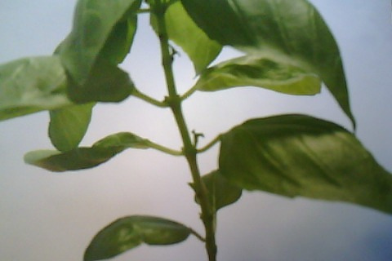
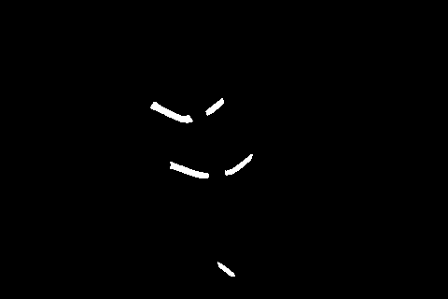
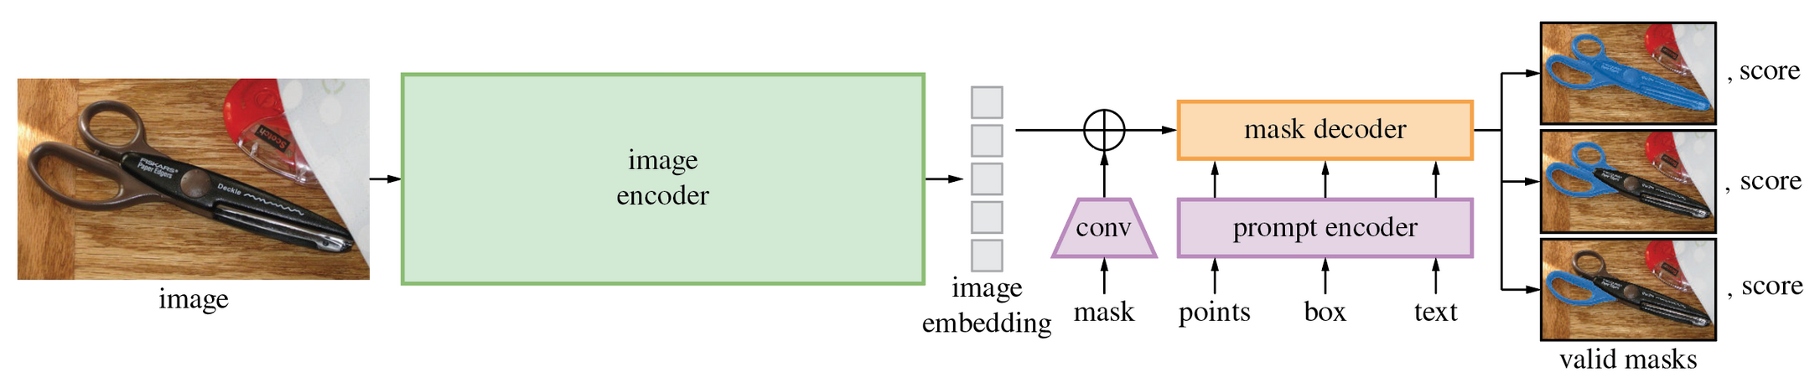
Segmentation Pipeline
Use of Segment Anything Model (SAM) with LoRA fine-tuning
Outperforms YOLOv11-seg, DeepLabv3, Mask R-CNN
Custom dataset: annotated petiole masks
Output: petiole segmentation mask
Notes:
At the core of the segmentation pipeline is Meta’s Segment Anything Model, or SAM. It’s a powerful foundation model (trained on huge amounts of raw data, generally with unsupervised learning and can be adapted to accomplish a broad range of tasks e.g. LLMs) SAM was the first foundation model for CV. It was trained on millions of masks and can segment arbitrary objects based on prompts — such as a point or bounding box and text (not released).
To specialize SAM for petiole segmentation and very importantly remove the need for a prompt, which would not be feasible for a real-time robotic system I fine-tuned SAM using Low-Rank Adaptation (LoRA).
Here we have SAM's architecture. The image encoder and prompt encoder were not touched. Only the mask decoder was targeted. LoRA works by inserting small trainable matrices that are updated during training in the decoder. These matrices learn how to adapt the frozen pre-trained weights to my specific task — segmenting basil petioles.
I created a custom training dataset of basil images and petiole masks. During training no prompts were given. So, basically LoRA adaptation allowed SAM to learn "what a petiole looks like". And now the model can directly predict the petiole mask from a image, enabling fully autonomous segmentation.

Slide 8
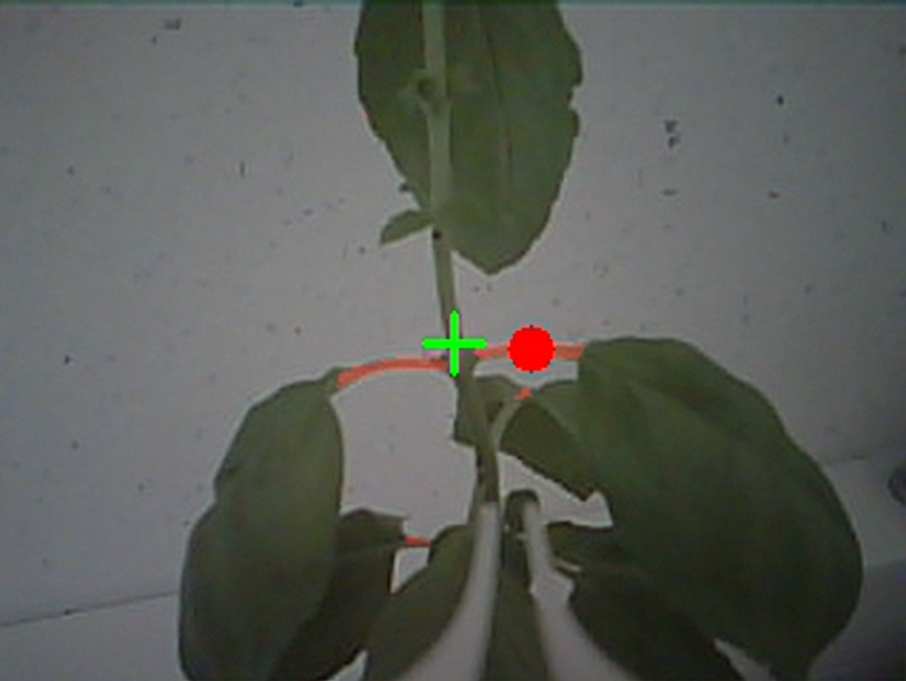
Cut Point Extraction
Select largest petiole
Cutting point = mask centroid
Show visual of mask + selected point + frame center
Notes:
Now that we have a nice mask of the petiole we can extract a cut point. After segmenting the petiole , the first step is to identify the largest connected mask, corresponding to the largest and most visible petiole in the scene.
Then, I calculate the centroid of that mask — the geometric center — and use it as the cutting point represented by the red dot. Ideally, you would cut right next to the stem but I decided for this project to cut at the center of the petiole for plant safety reasons. cutting too close to the stem could leed to accidentaly damaging it and ruining the whole plant.
If you are asking what the green cross is, that's the center of the frame and will explain that in the next slide

Slide 9
Visual Servoing
IBVS - a visual control strategy in robotics that uses features extracted from camera images to guide robot motion
Feedback loop: center → approach → cut
Centering: align cutting point (x, y) with frame center
Send offset (dx, dy) to ESP32
ESP32 adjusts servos for horizontal (x) and vertical (y)
Approach: mask size as proxy for distance
Trigger cut when close enough
Key Idea:
Control the robot so that the visual error between the current and desired image features is minimized.
Notes:
Like I said before I use IBVS as my control strategty. The idea behind IBVS is very simple: we use visual information — in this case, the position of the petiole and the point in the image — to control the robot. Rather than mapping that point to real world coordinates and using kinematics to reach it, I only care about how it appears in the image and of course move in such a way so it appears correct in the camera frame.
The control pipeline uses visual feedback to guide the robot in three stages:
1. Centering: where the goal is to align the cutting point with the frame center and the way to do this is just to calculate
dx and dy which represent how far the target is from the center and send this offset to the controller which adjusts the servos accordingly.
If the point appears too far left, the robot rotates right.
If it appears too high, it adjusts downward, and so on. The system operates in a closed-loop, constantly adjusting to what it sees. Step size increases if the offset is large. If is 0 or almost 0 then it centered it and moves on to the next stage
2. Approaching: tricky because as I have already mentioned we have no depth information and don't actually know how far it is.
So after centering, the robot gradually starts to move closer, using the mask size as proxy for distance to estimate how far it is. Because as you all know when you look at an object from the distance it apppears small, but as you get close it gets bigger. So, I use the same logic here.
If the mask area exceeds a threshold, the robot is considered "close enough" and proceeds to cut.
This is the main idea. However, now after some design changes when getting really close the mask actually starts to shrink and eventually completely dissapear because it's not in the field of view anymore, it's lower and can't be seen in the frame. When this happens once the mask dissapeared it assumes that its close enough and cuts.
3. Cutting

Slide 10
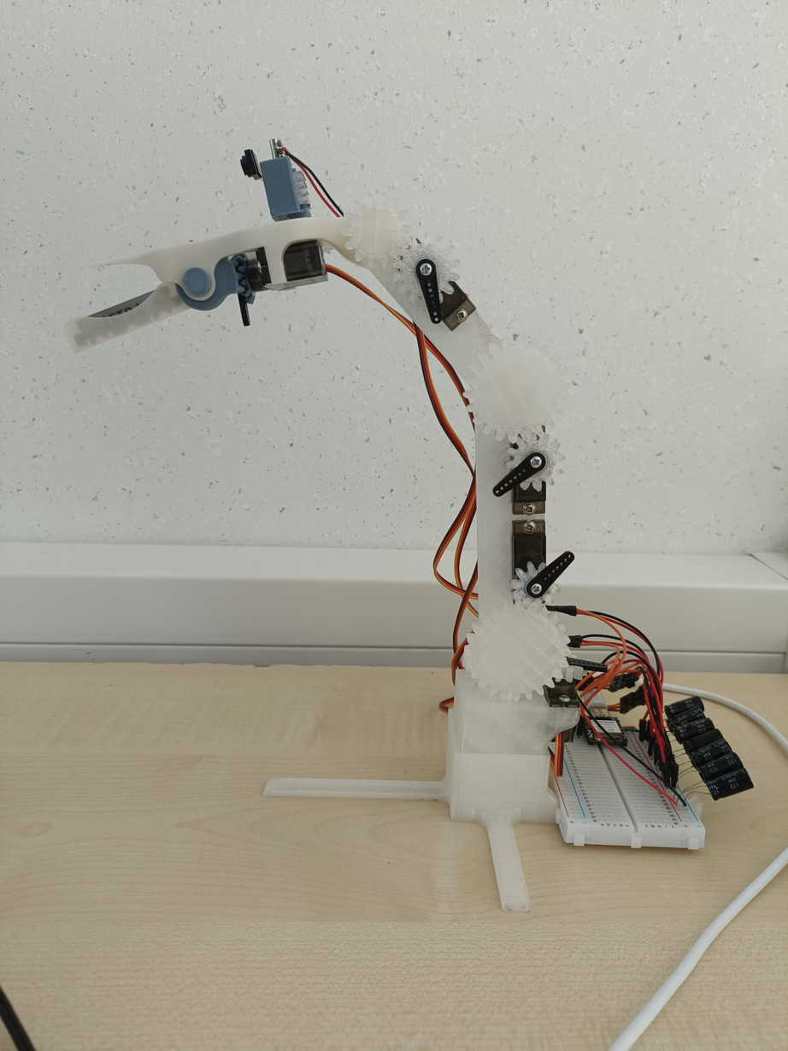
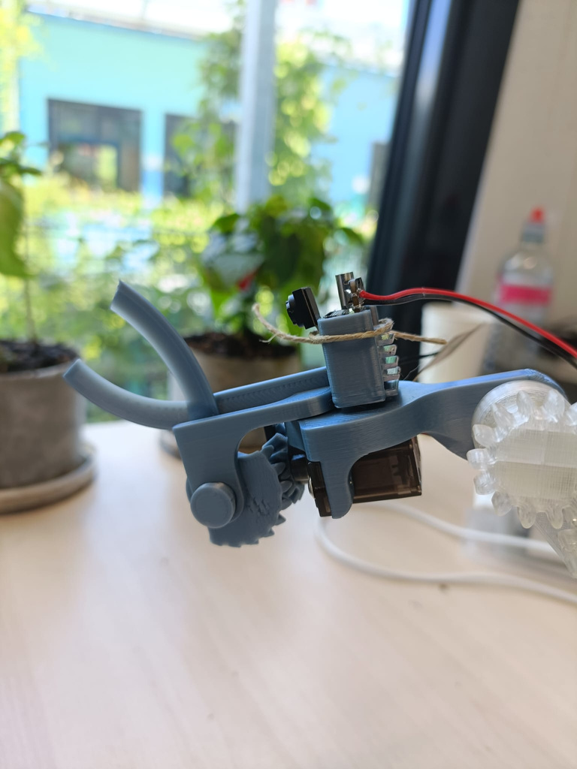
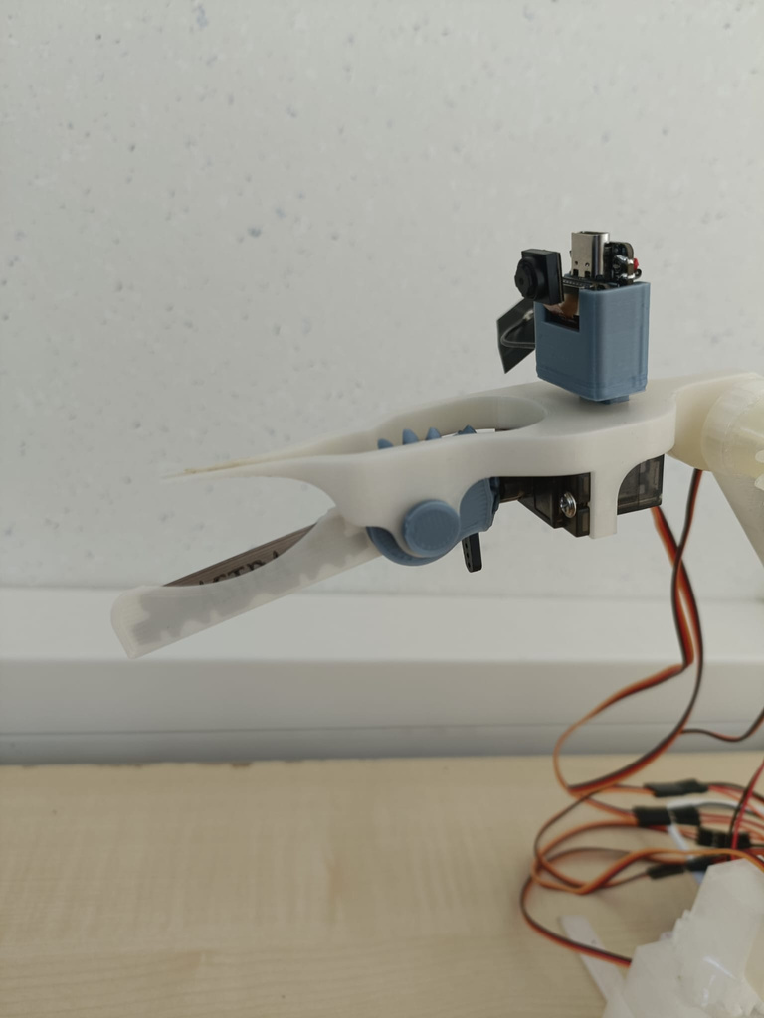
Hardware Setup
Robot Arm: 5 DoF, MG90S servos
Controller: ESP32-S3
Camera: OV2640 (ESP32-CAM)
Notes:
The hardware is intentionally low-cost. The robot arm is 3d printed and it has 5 degrees of freedom
base servo - horizontal rotation left/right (yaw)
shoulder, elbow, wrist - vertical rotation, extending/retracting the arm
and the end effector which is a cutting mechanism. Early iteration: entirely 3d printed, it was not sharp enough so an actual blade had to be added and it was also obstructing the camera view so it had to be moved lower. that's why now the mask dissapears when getting very close. It cant actually see what it cuts.....
and is driven by MG90S servo motors. The ESP32-S3 acts as the controller and communicates with the PC over serial. The RGB camera used is the OV2640, which streams frames over Wi-Fi. This setup ensures minimal cost while maintaining decent precision and responsiveness.

Slide 11
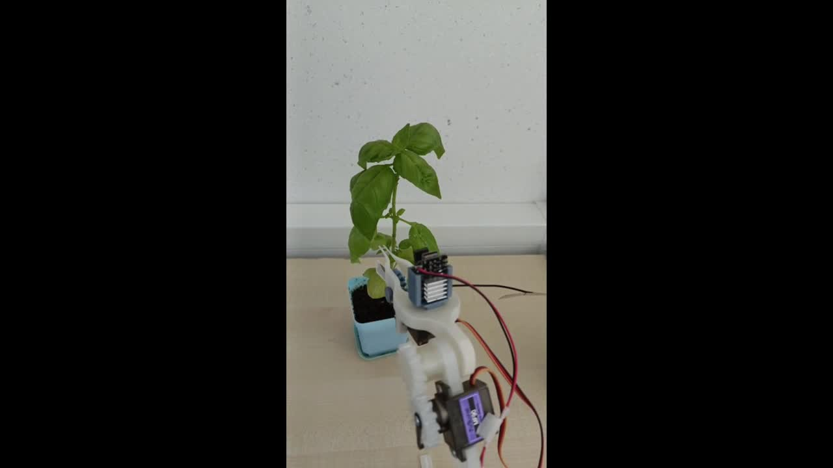
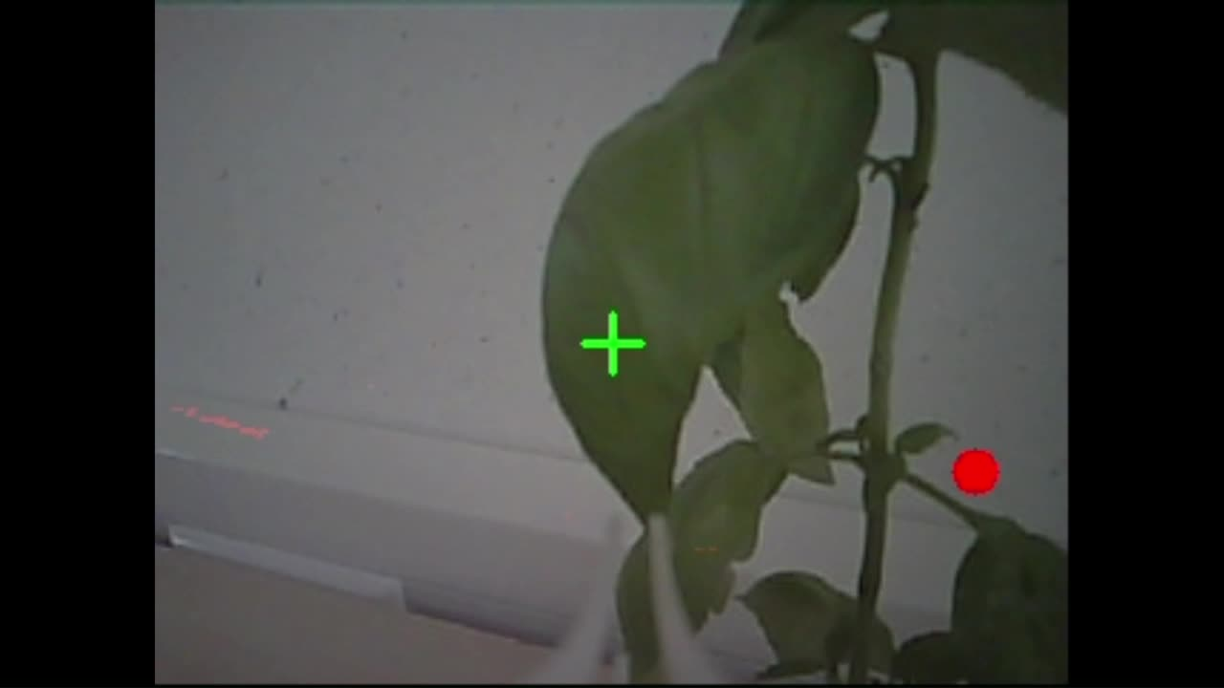
Experimental Results
Notes:
Now I’ll show some short videos of how the system works
You'll see the robot’s camera feed on the left, with a segmentation mask overlaid on the petiole.
Once the petiole is centered, the robot starts approaching it — you'll notice the ‘Centered!’ message appears briefly.
As it gets closer, the mask gets larger, but then its getting smaller until it eventualy dissapers and then cuts.

Slide 12
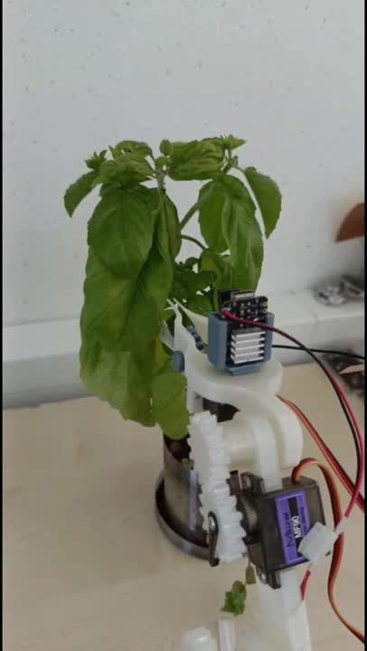

Slide 13
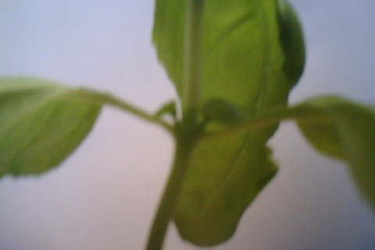
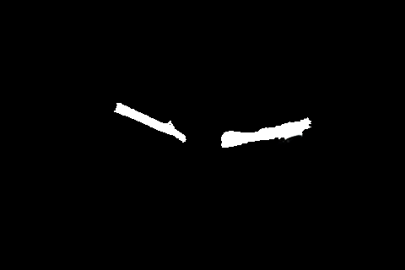

Results & System Performance
Segmentation accuracy
Dice Score: 0.63
IoU (Intersection-over-Union): 0.51
Visual Servoing Behavior
Centering success rate: ~95%
Approach stability: Mask often shrinks/lost at close range
Cutting success rate: 40%
Total hardware cost: < €50
RGB image
Ground truth mask
Predicted mask
Notes:
These are the current performance results.
The segmentation model achieved a Dice score (f1 score)of 0.63 and IoU (Jaccard) of 0.51. They are both used to measure how well the predicted mask by segmentation model overlaps with the ground truth.
Both scores indicate a moderate performance, that is due to the low-resolution camera. (similar background)
Even so, in reality the segmentation is still very effective to guide the robot.
The visual servoing system could center on the petiole almost every time. However, during the approach phase, the mask starts to disappearer due to the camera positioning and this can sometimes trigger early cutting, missing the leaf.
Overall, the cutting success rate was around 40%. This reflects both segmentation challenges and limitations of approach strategy.
Still, with basic components worth less that €50, the system managed to execute full cut cycles, showing that a low-cost vision-based harvesting solution is technically achievable.
One of the most promising improvements would be to add a second camera and implement stereo vision, also modify a bit the design.
This would provide reliable depth estimation during the approach phase which ended to be the main problem of this project.

Slide 14
Conclusion
The system demonstrates that it is feasible to build an autonomous, vision-guided basil harvester using:
Only a monocular RGB camera
A fine-tuned segmentation model (LoRA-SAM)
Closed-loop visual servoing on low-cost hardware (ESP32 + servos)
Key Outcomes
Real-time petiole detection and control with no depth sensor
End-to-end harvesting cycle: segment → center → approach → cut
Total system cost under €50
Cutting success rate: 40% — with clear room for improvement
Notes:
To conclude: I set out to test whether a low-cost robotic system could detect and harvest basil using only RGB vision.
The answer is yes — to a meaningful degree.
The system I built performs segmentation, control, and cutting using just a basic camera and a lowcost robot arm.
While cutting accuracy is limited — around 40% — the overall pipeline works autonomously and reliably in many trials.
The results validate the core concept and show that it’s possible to approach precision harvesting without expensive hardware.
With targeted improvements, the system can become much more robust and useful in real-world settings.

Slide 15
Vrije Universiteit Amsterdam | 2025
Master’s Thesis
Vision-Guided Robotic System for Basil Harvesting
Presented by Marin Marian
Thank You
Notes:
That concludes my presentation. Thank you for your time and attention — I’d be happy to take any questions.

